Slide 1




P.T.Lee CHENGALVARAYA NAICKER COLLEGE OF ENGINEERING AND TECHNOLOGY Vallal P.T.Lee chengalvaraya naicker nagar, Oovery, Kanchipuram - 631502
DEPARTMENT OF MECHANICAL ENGINEERING
DITTO – THE ADVANCED LEAD THROUGH ROBOT
SECOND REVIEW
DATE : 11-05-2022
TEAM MEMBERS
K.Dinakaran | (511518114005)
B.Ranjith kumar | (511518114018)
V.Sakthivel | (511518114020)
A.Santhosh kumar | (511518114023)
UNDER THE GUIDANCE OF
MR.PRAKASH .M.E , Assistance professor (MECH)

Slide 2
INTRODUCTION
Recently robots are widely used in a various field particularly in the industry. Despite this fact robot still requires an undeniable amount of knowledge from the operators or workers who deal with them. As a result, robots cannot be easily programmed if the operator or the worker is not experienced in robotics field.
One of the programming methods that has been introduced to make programming task user friendly is lead-through robot programming. However, the existing lead-through programming methods still requires an amount of knowledge that is not available for most of the operators and workers.
The main objective of this project is to design a lead through method for point to point robot programming using incremental encoder feedback, which can record, save and playback the robot motion while considering the accuracy and precision of the robot. To validate the method, experiments were conducted in this project, where an operator manually moves a two DOF (degree of freedom) robotic arm on a white board while the encoder feedback was recorded and later played back by the robot. Then both recorded and playback trajectories were compared and analyzed.

Slide 3
ABSTRACT
The main objective of this project is to design a lead through robot for point to point robot programming using dimensional scaling of a real-time robot to a scaled down model.
This robot, we can record, save and playback the robot motion with accuracy and precision. This root the workers to not strain to program the robot by moving the nose of huge real-time robot but through the scale downed duplicate. This ensures the method of programing much easier to use.
On the actual scenario of programing, the real-time robot offers resistance to motion which causes the operator to strain to move it to required positions. This issue can be overcome through this scale down method with greater reduction in latency of relocating the nose trajectory.

Slide 4
OBJECTIVE
The main objective of this project is to build a robot that will be embedded with a robotic arm and can be controlled using new lead through method.
The robot can move to remote places and do the pick & place action of objects that are dangerous and harmful. The applications of this project is vast and can be implemented in a lot of industries.
To create a pick and place robot with lead through method for point to point robot programming using angular and dimensional scaling of an real-time robot to a scaled down model.
To increase the pick-and-package global performance in terms of flexibility, dependability and error reduction.
Improvement of the working conditions of operators by a proper layout design and task allocation between worker and robot.

Slide 5
MOTIVATION OF THE PROJECT
To provide an update on Teaching by Demonstration / Lead through method of programming.
Rather than moving a real time robot’s end effector with our muscular efforts, we can make a scaled down model in order to achieve the same motion in a simple way.
This method will be much easy, convenient and highly flexible to program a robot with non purposeful, wide application oriented situations.
Through this method, we can reduce the halted time of the industrial robot.
It will not require skilled craftspeople who are unfamiliar with programming.
Quicker than traditional teach pendants. We can reduce the end up wasting time sorting out by the old simulator issues instead of solving production challenges.
It reduces the need for multiple button pressing, allowing the operator to simply move the robot to the desired position.
Very good for detailed tasks which would require many lines of code to achieve the same effect, such as welding or painting of intricate shapes.

Slide 6
EXISTING SYSTEM
1. Simulation/Offline Programming
Programming offline does not interfere with production too much. Offline programming allows the robot to be programmed using a virtual mockup of the robot and task. If the simulation software is intuitive to use, this can be a quick way to test an idea before moving it to the robot.
Disadvantages:
Virtual models will (probably) never be able to represent the real world with 100% accuracy. Programs may still need to be altered after they are applied to the real robot.
Might take longer overall. Although offline programming reduces the downtime of the robot, it means that someone has to spend extra time developing the simulation, as well as testing it on the robot.
Can sometimes end up wasting time sorting out simulator issues instead of solving production challenges. This could be related to the quality of the simulator.

Slide 7
EXISTING SYSTEM
2. Teaching Pendant/Drive Through
over 90% of robots are programmed using this method. Often consists of a giant handheld calculator. To program the robot, the operator moves it from point-to-point, using the buttons on the pendant to move it around and save each position individually. When the whole program has been learned, the robot can play back the points at full speed.
Disadvantages:
Disruptive to the whole system due to robot downtime. The robot must be put into "teach mode" and all operations using the robot halted until it has been programmed.
Requires training to learn and program.
Might be difficult for skilled craftspeople who are unfamiliar with programming.

Slide 8
EXISTING SYSTEM
3. Teaching by Demonstration/Lead Through
These methods involve moving the robot around, either by manipulation a force sensor or a joystick attached to the robot wrist just above the end effector. As with the teach pendant, the operator stores each position in the robot computer as it is easy for operators to get started immediately using the robot with their applications.
Disadvantages of Teaching by Demonstration
As with traditional a teach pendant, this method uses the physical robot for programming. This means that it does not reduce downtime, as much as offline programming.
Moving the robot to precise coordinates is not as straightforward as with the other methods. This is especially true with some joystick based systems, where there is no way of entering a numerical value.
Not so good for tasks which are "algorithmic" in nature. For example, if a robot had to paint a flat surface by moving horizontally along the surface, then move down an inch, move horizontally in the opposite direction, etc. Moving the robot by hand would be hard and inaccurate for such a task.

Slide 9
LITERATURE SURVEY
S.No | Title of the project with author name | Journal Name | Year of Publication | Methodology | Pros & Cons
1. | A Review on Design and Development of Pick and Place Robotic Arm (Prof. S.D Rajgure , Aakash D Chougale, Ajit N Bhatkande, Suraj A Bhamare, Swaroop S Chougale) | IOSR Journal of Mechanical and Civil Engineering (IOSR-JMCE) | 2018 | Pneumatic robotic arm for automation using compressed air supply. | high speed of robot gripping element Less reliable , It requires number of cylinder and pistons.
2. | Development of Pick And Place Robot for Industrial Applications (Vishakha Borkar, Prof G.K.Andurkar) | International Research Journal of Engineering and Technology (IRJET) | 2017 | Radio packet controller. able to command and control the Robot wirelessly by the GUI application. | Can control the robot wirelessly Requires multiple buttons, knobs & keys to program the robot.

Slide 10
LITERATURE SURVEY
S.No | Title of the project with author name | Journal Name | Year of Publication | Methodology | Pros & Cons
3. | Robotic arm for pick and place application (Kaustubh Ghadge, Saurabh More, Pravin Gaikwad, Shrenik Chillal ) | International Journal of Mechanical Engineering and Technology (IJMET) | 2018 | Android application will send a signal to NodeMCU. then it will make a response to devices such as servo motors | robot with stereo camera. a task requires visual Processing. High latency, low resolution of frame work.
4. | Review on design and development of intelligent robotic arm (Netra Barai, Swati Manekar) | IEEE 9th International Conference on Intelligent Systems and Control (ISCO) | 2015 | robot will record the actions when performed by the user during the `learning phase' and gives sequence of recorded motion codes. | Can generate motion codes that can be logged. neuro-fuzzy approach has fluctuating noise on motion play.

Slide 11
BASE PAPER
“Sensorless kinesthetic teaching of robotic manipulators assisted by observer-based force control” by Martino Capurso, M. Mahdi Ghazaei Ardakani, Rolf Johansson, Anders Robertsson and Paolo Rocco.
This paper let us to know the programing strategy that is needed for industrial robots with the revolution of automation.
In this paper they mentioned, it is vital to be able to reprogram robots quickly. Kinesthetic teaching, also known as lead-through programming (LTP), provides a fast approach for teaching a trajectory.
In this approach, a trajectory is demonstrated by physical interaction with the robot, i.e., the user manually guides the manipulator. This paper presents a sensor less approach to LTP for redundant robots that eliminates the need for expensive force/torque sensors.
Through this paper, we thought that “why don’t a robot can be controlled through a scale down model in spite of fixing sensors to the arm?” so that it will be much more reliable and fast... Thereby we can do the same recording the motion, play and resetting path.

Slide 12
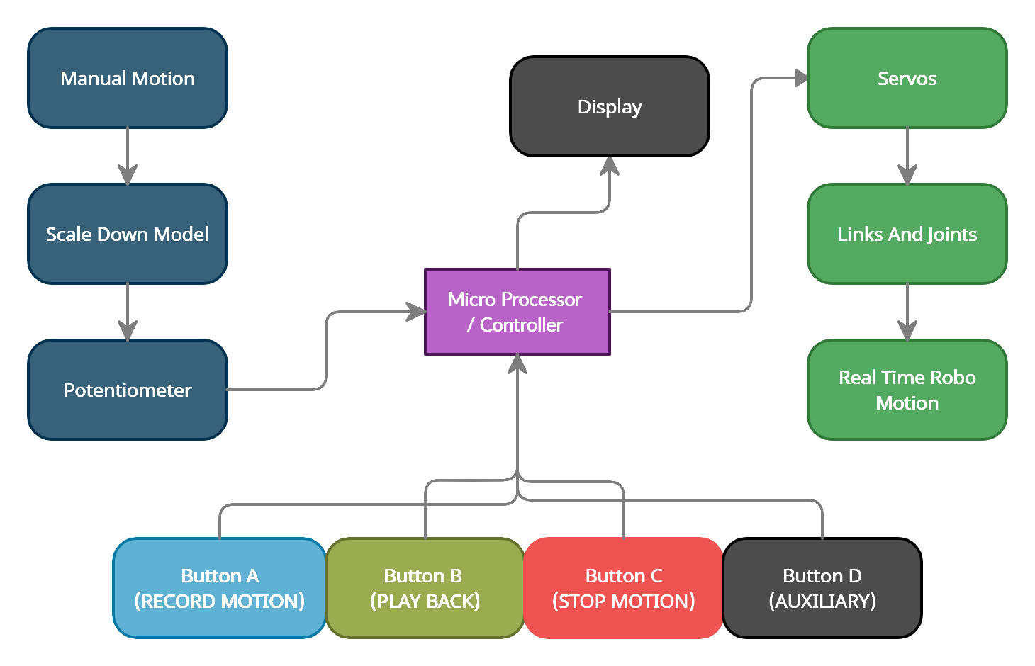
BLOCK DIAGRAM

Slide 13
METHODOLOGY & WORK FLOW
Step-1 : We going to move the scale down model.
Step-2 : The potentiometer is attached to the model will gives the output voltage with reference to the power supply and the angle of the scale down model.
Step-3 : These output voltages from each joints of the scale down model are then converted to angles through micro controller.
Step-4 : In the real-time robot, we will have servo motors for angular twist of the arm. So we will control the servo through the angles obtained from the microcontroller with data from the potentiometer of the scale down model.
So through programing, we can lively control the real-time robot with a small scale down model.
Later, when we need to record some required motion, we have switches for saving the angles, replay the position and to reset the program memory.
Through display device like computer, we can lively monitor the actions performed by the robot with clear data that can be saved and documented for future references.

Slide 14
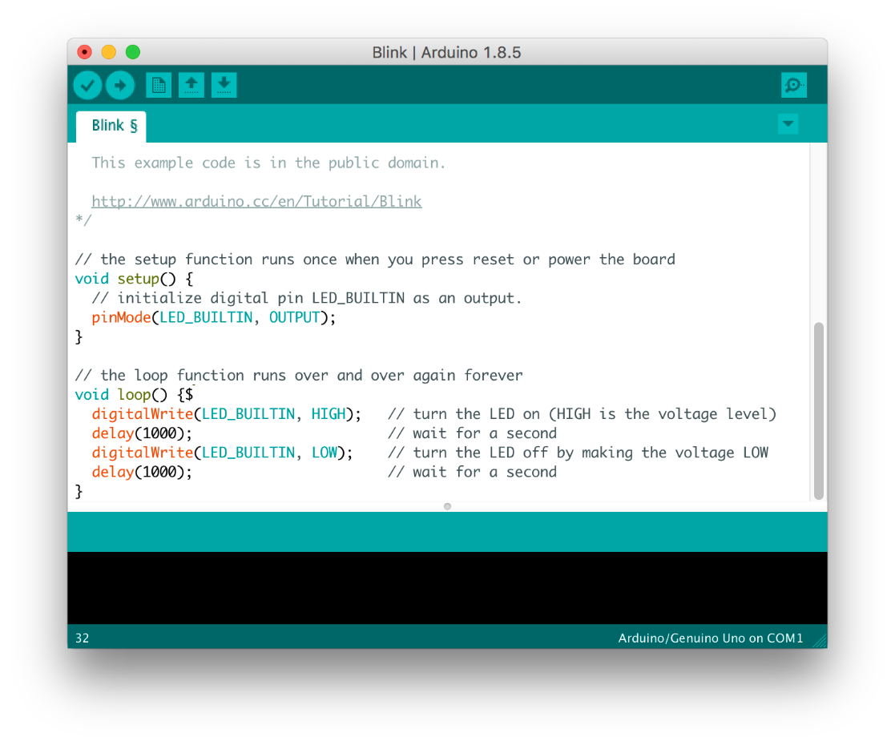
Software - Arduino IDE 1.8.13
The Arduino Integrated Development Environment (IDE) is a cross-platform application (for Windows, macOS, Linux) that is written in functions from C and C++. It is used to write and upload programs to Arduino compatible boards, The Arduino IDE supports the languages C and C++ using special rules of code structuring.
User-written code only requires two basic functions, for starting the sketch and the main program loop, that are compiled and linked with a program stub main() into an executable cyclic executive program with the GNU toolchain, also included with the IDE distribution.

Slide 15
Program used to obtain angular data from potentiometer of the scale down model
PROGRAM TO OBTAIN JOINT ANGLES
int Read_Pin1 = A1;
int Read_Pin2 = A2;
int Read_Pin3 = A3;
int Read_Pin4 = A4;
int Read_Pin5 = A5;
void setup()
{
pinMode(Read_Pin1, INPUT);
pinMode(Read_Pin2, INPUT);
pinMode(Read_Pin3, INPUT);
pinMode(Read_Pin4, INPUT);
pinMode(Read_Pin5, INPUT);
Serial.begin(9600);
}
void loop()
{
Analog_Read();
// Mapping();
}

Slide 16
void Analog_Read()
{
int Pin_Value1 = analogRead(Read_Pin1);
int Pin_Value2 = analogRead(Read_Pin2);
int Pin_Value3 = analogRead(Read_Pin3);
int Pin_Value4 = analogRead(Read_Pin4);
int Pin_Value5 = analogRead(Read_Pin5);
Serial.print("Pin_Value1 ");
Serial.print(Pin_Value1);
Serial.print(" ");
Serial.print("Pin_Value2 ");
Serial.print(Pin_Value2);
Serial.print(" ");
Serial.print("Pin_Value3 ");
Serial.print(Pin_Value3);
Serial.print(" ");
Serial.print("Pin_Value4 ");
Serial.print(Pin_Value4);
Serial.print(" ");

Slide 17
Serial.print("Pin_Value5 ");
Serial.print(Pin_Value5);
Serial.println("");
}
void Mapping()
{
int Pin_Value1 = analogRead(Read_Pin1);
int Map_Value1 = map(Pin_Value1, 0, 1023, 0, 180);
Serial.print("Pin_Value1 ");
Serial.print(Pin_Value1);
Serial.print(" ");
Serial.print("Map_Value1 ");
Serial.println(Map_Value1);
}
From the above program we can take the link angles of a miniature model of pick and place robot.
In the next step, we going to operate the real-time robot with the angle data obtained from the above. So that we can control a real-time robot in live remote control method.

Slide 18
PROGRAM DESCRIPTION
we can read all the Potentiometer of the scale down model. so we can take readings from the scale down model and can display it in computer monitor.
In the program, we assign analog pins with integer datatype.
Then it moves to void setup which will perform the operation just once and skip to the void loop. In the void setup we will assign what type of pins that actually and they are input or output and also the serial monitor also can be executed right here.
Void loop will consist of set of program which will loop continuously. We used a function call technique so it will has a set of programs belongs to it.
In this call, the pin values are read through analogue read function and it is stored in assigned variables. These are then called and printed through serial monitor from the system.
there is also another type of function called mapping. It converts 0 to 1023 value to 0 to 180 degrees of angle. this angle can be obtained as a output in system monitor.

Slide 19
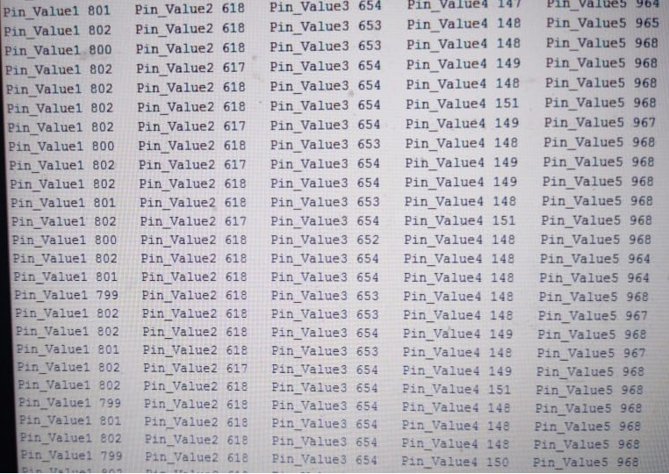
We can see the pot values from the miniature model that controls the real-time robot.
Working on the progress of recording, playing and resetting the motion of model so as to duplicate it to the real-time robot.

Slide 20
Program used to lively operate a real time robot through a scale down model
PROGRAM TO LIVE CONTROL THE REAL-TIME ROBOT
#include <Servo.h>
Servo servo_a;
Servo servo_b;
Servo servo_c;
Servo servo_d;
Servo servo_e;
int pot1;
int pot2;
int pot3;
int pot4;
int pot5;
int angle1;
int angle2;
int angle3;
int angle4;
int angle5;

Slide 21
void setup()
{
Serial.begin(9600);
servo_a.attach(5);//gripper
servo_b.attach(6);//roll
servo_c.attach(9);//elbow
servo_d.attach(10);//shoulder
servo_e.attach(11);//base
}
void loop()
{
pot1=analogRead(A1);
angle1=map(pot1,0,1023,170,0);
servo_a.write(angle1);
Serial.println(angle1);
pot2=analogRead(A2);
angle2=map(pot2,0,1023,170,0);
servo_b.write(angle2);
Serial.println(angle2);

Slide 22
pot3=analogRead(A3);
angle3=map(pot3,0,1023,170,0);
servo_c.write(angle3);
Serial.println(angle3);
pot4=analogRead(A4);
angle4=map(pot4,0,1023,0,170);
servo_d.write(angle4);
Serial.println(angle4);
pot5=analogRead(A5);
angle5=map(pot5,0,1023,0,170);
servo_e.write(angle5);
Serial.println(angle5);
Serial.println("");
//delay(300);
}
From the above program we can control the real-time robot lively through a small model and we can also take the link angles of a miniature model of pick and place robot.
In the next step, we going to save the path moved by the model and play it to the real-time robot.

Slide 23
PROGRAM DESCRIPTION
Our current work status is we can control the real-time robot on live and also can read all the Potentiometer values of the scale down model. so we can carry over the readings from the scale down model and can display it in computer monitor.
In the program, we included a servo library and assigned analog pins with integer datatype.
Then it moves to void setup which will perform the operation just once and skip to the void loop. In the void setup we will assign what type of pins that actually and they are input or output and also the serial monitor also can be executed right here.
Void loop will consist of set of program which will loop continuously. We used a function call technique so it will has a set of programs belongs to it.
In this call, the pin values are read through analogue read function and it is stored in assigned variables. These are then called and printed through serial monitor from the system. Later we can write those values into the servos of the real-time robot.
In future, the path moved by the small model can be recorded and can be played back repeatedly by the real-time robot.

Slide 24
HARDWARE USED :
Arduino UNO
High Torque Servo Motors
Rotary Potentiometers
USB to TTL Converter
5V Adopter
PCB Board
Male Pin Connectors
Female to Female Jumper Cable
Resistors and Push Buttons
Pick and place robot 3D printed frame
Laptop for display
SOFTWARE USED :
Arduino IDE 1.8.13

Slide 25
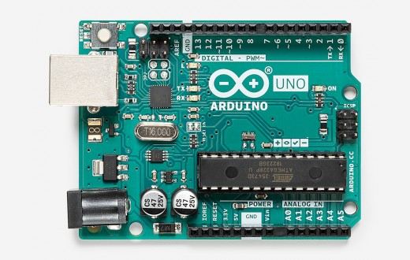
Arduino UNO
An open-source microcontroller board based on the Microchip ATmega328P microcontroller and developed by Arduino.cc. The board is equipped with sets of digital and analog input/output (I/O) pins that may be interfaced to various expansion boards (shields) and other circuits. The board has 14 digital I/O pins (six capable of PWM output), 6 analog I/O pins, and is programmable with the Arduino IDE (Integrated Development Environment), via a type B USB cable. It can be powered by the USB cable or by an external supply.

Slide 26
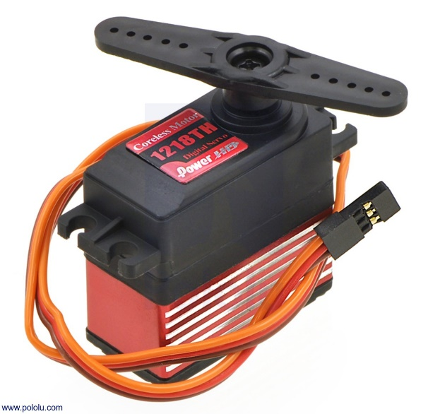
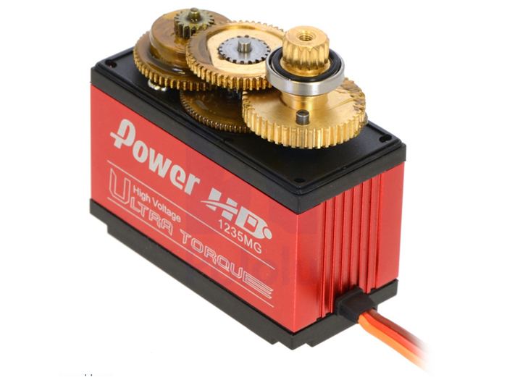
High Torque Servo Motors
A rotary actuator that allows for precise control of angular or linear position, velocity and acceleration. It consists of a suitable motor coupled to a sensor for position feedback. It also requires a relatively sophisticated controller, often a dedicated module designed specifically for use with servomotors.
Servomotors are not a specific class of motor, although the term servomotor is often used to refer to a motor suitable for use in a closed-loop control system.

Slide 27
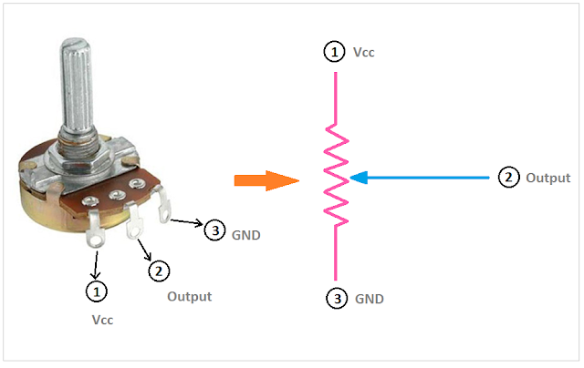
Rotary Potentiometer
A three-terminal resistor with a rotating contact that forms an adjustable voltage divider. Potentiometers consist of a resistive element, a sliding contact (wiper) that moves along the element, If only two terminals are used, one end and the wiper, it acts as a variable resistor or rheostat. The measuring instrument called a potentiometer is essentially a voltage divider used for measuring electric potential (voltage). Potentiometers operated by a mechanism can be used as position transducers.

Slide 28
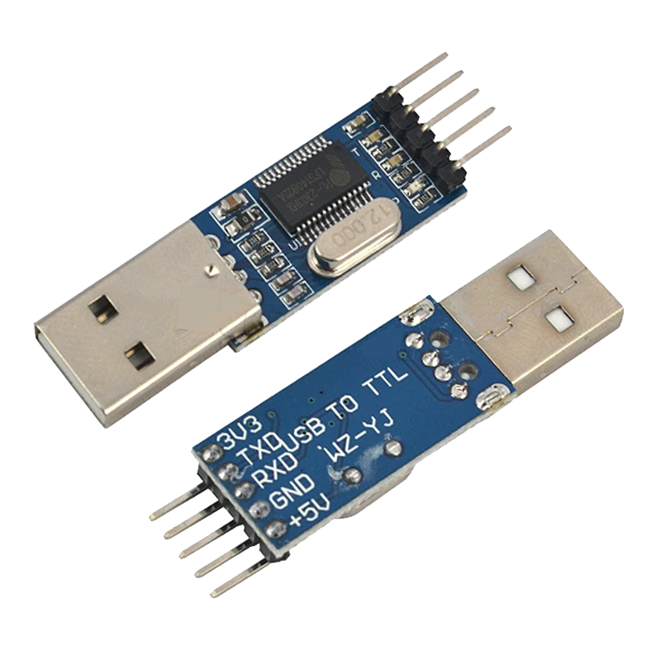
USB to TTL Converter
A TTL-USB converter is essentially required for the direct interfacing of modules to the PC, without an intermediate microcontroller or similar platform. We generally use TX and RX pins for communication.
We using a Type-2 RS232 TTL signal converter (Tx, Rx, +5V, Gnd). It is a serial with 2-pin connectors for mounting on a microcontroller board. where, 2-pin connector for power and another 2-pin connector for data.

Slide 29
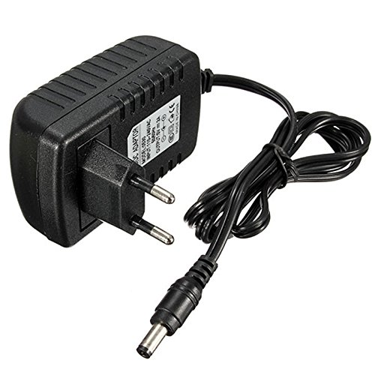
5V Adapter
5 Volt 1 Amp Power Adapter takes an AC INPUT of 100-240V and gives 5V 1A DC output.
This has the following features - Short Circuit, Over Voltage & Over Current Protection, Incredibly Low Fault Rates It's plug design is for Indian power socket so, no plug converter is required, Compact size & light weight, Regulated Stable Voltage Stabilized Output, low ripple & low interference, High Efficiency & low energy consumption.

Slide 30
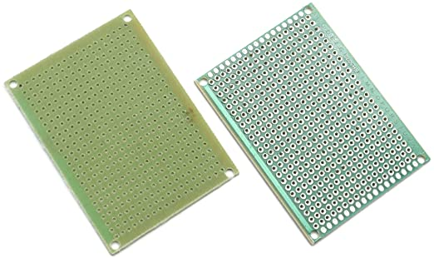
Printed Circuit Board
A printed circuit board (PCB) mechanically supports and electrically connects electrical or electronic components using conductive tracks, pads and other features etched from one or more sheet layers of copper laminated onto and/or between sheet layers of a non-conductive substrate. Components are generally soldered onto the PCB to both electrically connect and mechanically fasten them to it.

Slide 31
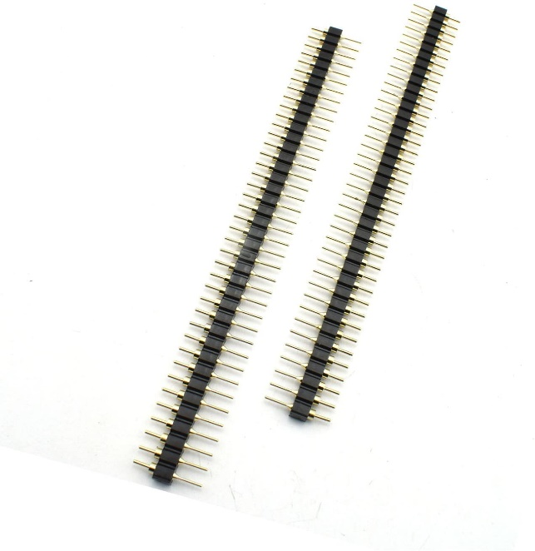
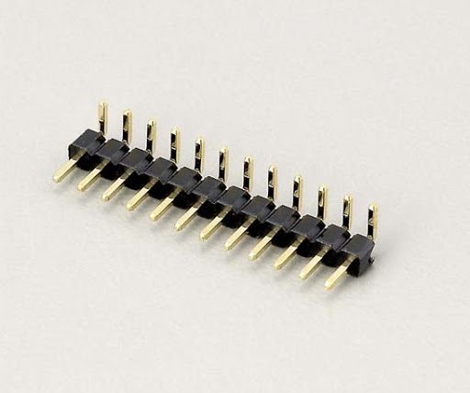
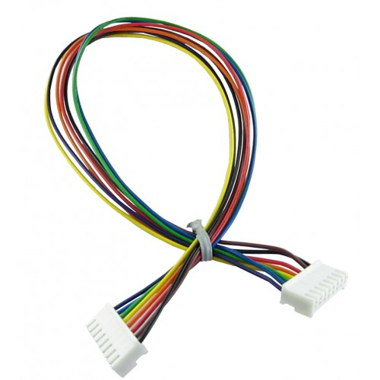
Connectors
Male Pin Header - A male pin header consists of one or more rows of metal pins molded into a plastic base, many spacing. can be either straight (vertical) or right-angle, the latter form is sometimes used to connect two PCBs together horizontally
Female to Female Jumper Cable - With this specially designed conversion cables, we can connect easily with a breadboard or other micro-controllers. They are used for connecting a Base Shield to a Grove sensor, actuator, or device.

Slide 32
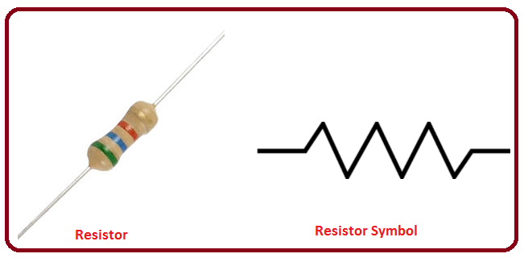
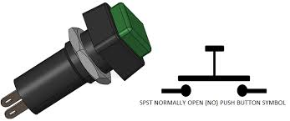
Resistor & Push Button
Resistors - A resistor is a passive two-terminal electrical component that implements electrical resistance as a circuit element. In electronic circuits, resistors are used to reduce current flow, adjust signal levels, to divide voltages, bias active elements.
Push Buttons - A Push Button is a type of switch work on a simple mechanism called “Push-to-make”. Initially, it remains in off state or normally open state but when it is pressed, it allows the current to pass through it or we can say it makes the circuit when pressed.

Slide 33
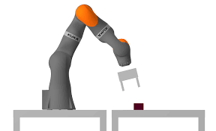
Pick and Place Robot Frame
A frame of a robot will carry the motors, electronics, mounting supports, and more. All of these components and parts are added to the weight of the chassis itself, which will count towards the total carrying capacity of the electrical motors. This enhances the best strength/weight ratio for a robot.
It provides a structural stability and dimensional clarity of a robot that helps us to determine the motion path and work volume of the robot.

Slide 34
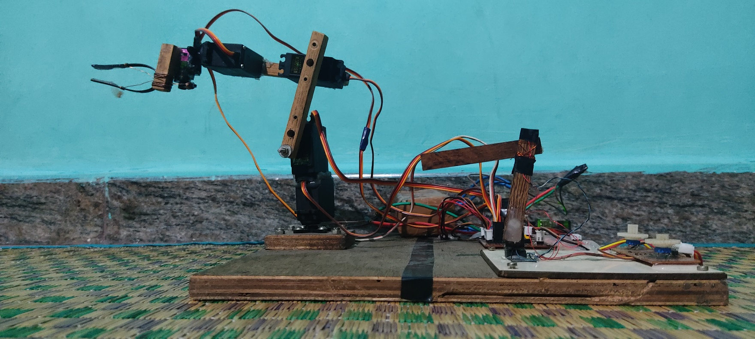
Hardware Results
In this project we made the real time robot move in live as we move the small model.
The small scale down model will gives us the resistive parameter while rotating the Pot knob in terms of 0-5 Volts or in integer, 0-1023. This value is converted into angular parameter and we give it as a input to servos through Arduino.
There by it replicates the actions performed by the small model to the huge real-time robot.

Slide 35
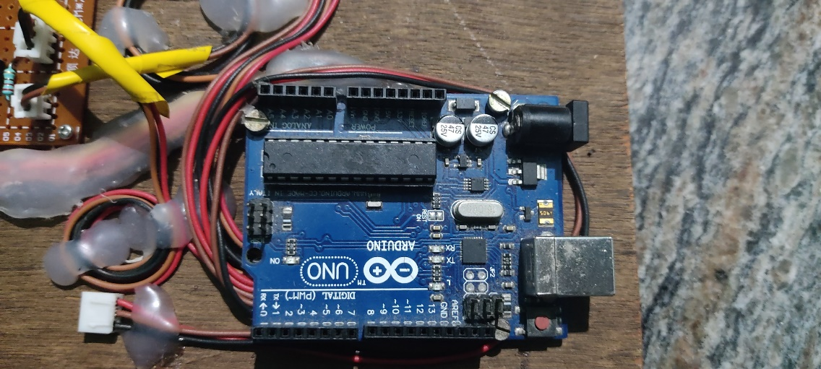
Arduino UNO
We used Arduino UNO. Since it has sufficient analog, digital, digital with PWM pin outputs (has 14 digital I/O pins (six capable of PWM output), 6 analog I/O pins).
Through this Arduino, we can upload and run the program.
Though it accepts voltages between 7 and 20 volts, we can power them with a external battery and can be monitor the output via data cable on the Laptop.
As we are using 5 analog, 5 digital with PWM and 3 digital pins, this board is more than enough for our purpose. As this board is capable of output voltage of 5 Volts, we can power to the Pots & Buttons.
Thereby we can get enough inputs and outputs to the external circuits as we explained above.

Slide 36
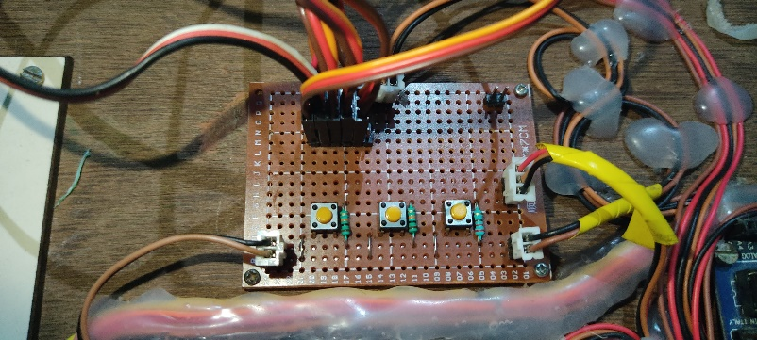
Circuit Board
We used a dotted PCB circuit board, through which we can mount the electronic components and can solder them.
In this circuit, we have 3 buttons for which we can record, play, reset the operation. These buttons are provided by the 5V power supply from the Arduino and are pulled down through a 1k resistor. so that whenever we press the button, the signal will be as ‘1’ to Arduino and whenever the button is free position, the value will be ‘0’.
We use the same concept to power the 5 Pots on the circuit. The power is obtained from Arduino of 5Volts and the signal is back to Arduino with varying voltage with respect to the angle of pot knob.
There are few tracks to provide power to 5 servos directly from the battery.
This board is screwed on to a plywood through screws. Also a removable one.

Slide 37
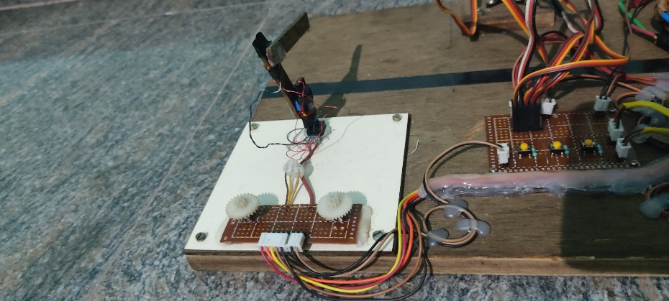
Scale Down Model
In this scale down model we have 5 potentiometers which will outputs a value range between 0 to 1023 based on the knob position,
The powering of this pot is done through Arduino and also the signals are carried over a cable to Arduino. Here, the three pots are mounted on the scale down model on positions of base, shoulder, elbow joints. So through these three e can control the mentioned joints of the real-time robot. As we mentioned above the pots will gives output of 0 to 1023… this value is converted in terms of joint angles i.e., 0-180 degrees.
This angular conversion is made by the Arduino through mapping function.
Thereby we can control the real-time robot by simply moving this small model.
The knob on the base will perform the twisting and gripping operation by rotating the knob.

Slide 38
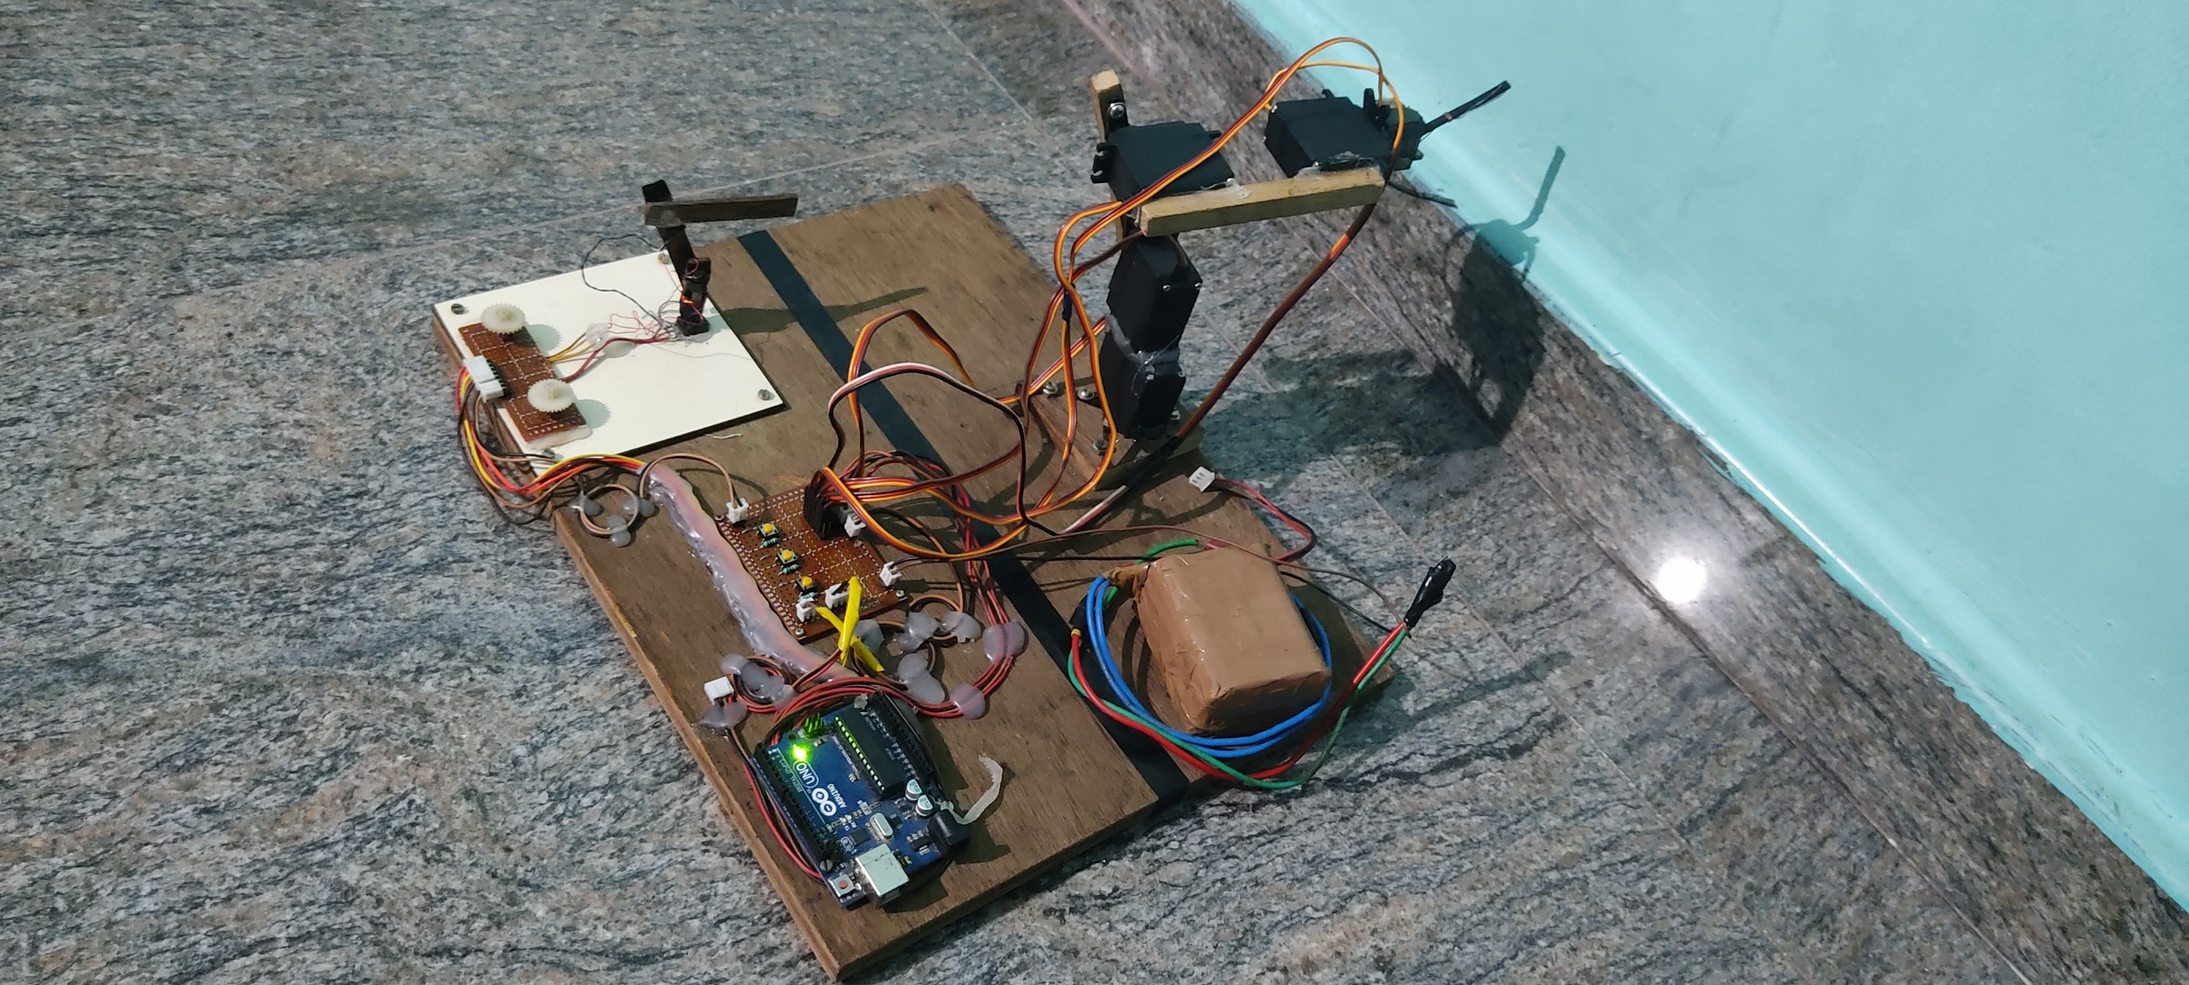
Complete View

Slide 39
References
Alexander Skoglund,Boyko Iliev,Bourhane Kadmiry,Rainer Palm, ‘Programming by Demonstration of Pick-and-Place Tasks for Industrial Manipulators using Task Primitives’, 2007 International Symposium on Computational Intelligence in Robotics and Automation.
Pei-Chi Huang,Aloysius K. Mok, ‘A Case Study of Cyber-Physical System Design: Autonomous Pick-and-Place Robot’ , 2018 IEEE 24th International Conference on Embedded and Real-Time Computing Systems and Applications (RTCSA).
Peng Hao; Tao Lu; Yinghao Cai; Shuo Wang, ‘Programming by Visual Demonstration for Pick-and-Place Tasks using Robot Skills’, 2019 IEEE International Conference on Robotics and Biomimetics (ROBIO)
Mahmoud Abdelaal,‘A Study of Robot Control Programing for an Industrial Robotic Arm’ 2019 6th International Conference on Advanced Control Circuits and Systems (ACCS) & 2019 5th International Conference on New Paradigms in Electronics & information Technology (PEIT)
Chaitanya S. Gajbhiye; Megha G Krishnan; S. Kumaravel; S. Ashok‘Fuzzy — Arduino based control strategy for human safety in industrial robots, 2017 IEEE International Conference on Signal Processing, Informatics, Communication and Energy Systems (SPICES)

Slide 40
References
Luka Peternel; Tadej Petrič; Jan Babič, ‘Human-in-the-loop approach for teaching robot assembly tasks using impedance control interface’, 2015 IEEE International Conference on Robotics and Automation (ICRA).
Martin Tykal; Alberto Montebelli; Ville Kyrki, ‘Incrementally assisted kinesthetic teaching for programming by demonstration’, 2016 11th ACM/IEEE International Conference on Human-Robot Interaction (HRI)
Christian Kohrt; Anthony Pipe; Gudrun Schiedermeier; Richard Stamp; Janice Kiely, ‘A robot manipulator communications and control framework’, 2008 IEEE International Conference on Mechatronics and Automation
Y. Kuniyoshi; M. Inaba; H. Inoue, ‘Learning by watching: extracting reusable task knowledge from visual observation of human performance IEEE Transactions on Robotics and Automation ( Volume: 10, Issue: 6, Dec 1994)
Rahul Kumar; Sunil Lal; Sanjesh Kumar; Praneel Chand,’ Object detection and recognition for a pick and place Robot Asia-Pacific World Congress on Computer Science and Engineering

Slide 41


